Slide 1
SMART SHE SHIELD TRACKER
TEAM NAME : DHINISHA TEAM
COLLEGE NAME : PROVIDENCE COLLEGE
DEP NAME: BSC DATA SCIENCE
TEAM MEMBERS
DHINISHA
MYTHILIESWARI

Slide 2
WHAT?
THE PROBLEM STATEMENT
1.LACK OF PROPER BUS ARRIVAL
2.WAIT FOR LONG HOURS
3.SAFETY RISKS
4. WASTAGE OF TIME
5. POOR COMMUNICATION BETWEEN THE DRIVER AND THE PASSENGERS

Slide 3
WHY?
1.SAFETY FOR WOMEN AND ELDERS
2.SAVE TIME, INCREASE CONVIENCE FOR VILLAGES
3. THERE IS NO SMART BUS SMART TRANSPORT ALERT
4. DELAY IN PUBLIC TRANSPORT AFFECT EDUCATION , ATTENDENCE AND LIVELIHOOD
5.BRIDGE BETWEEN TECHNOLOGY AND RURAL

Slide 4
HOW?
SENSOR
BUZZER
DETECT OR SENSE THE PRESENCE OF THE BUS
USED TO MEASURE THE DISTANCE
ACTS AS THE INPUT DEVICE
PRODUCES SOUND ALERT
NOTIFY THE PEOPLE
ACTS AS THE OUTPUT DEVICE

Slide 5
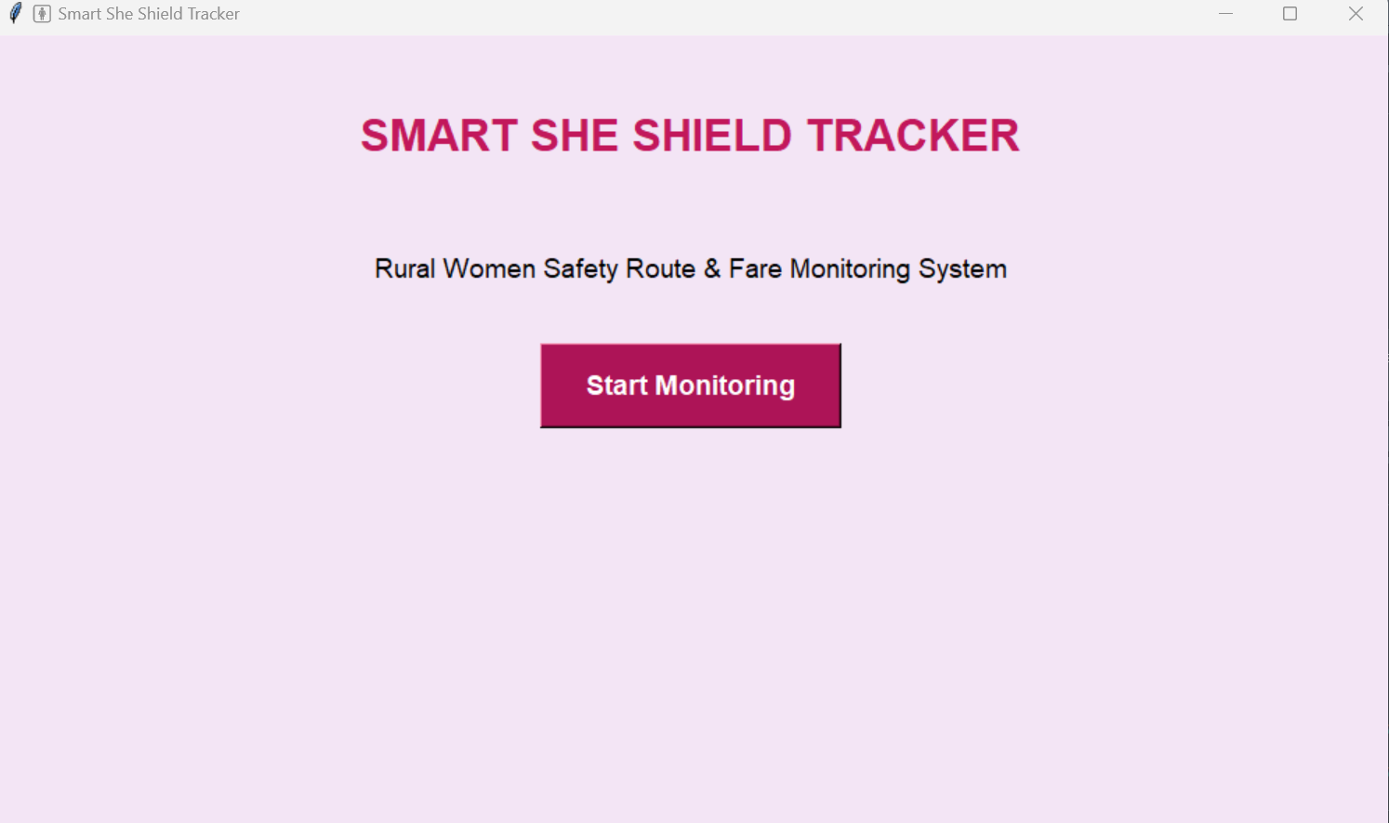
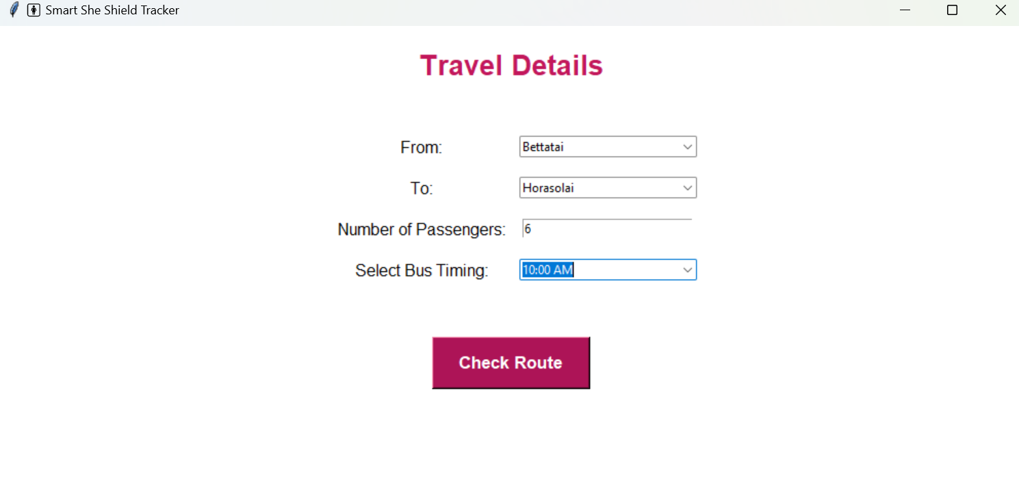
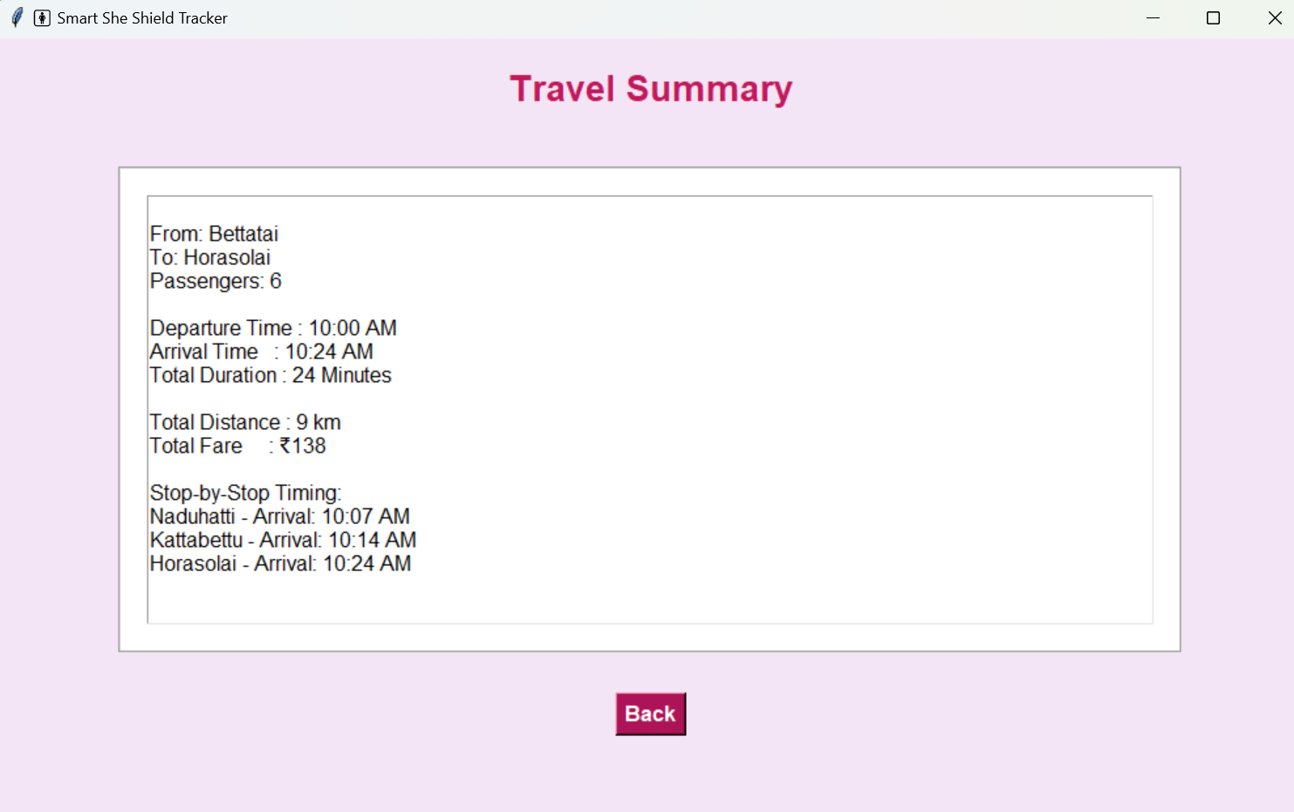
CODING PART EXECUTION

Slide 6
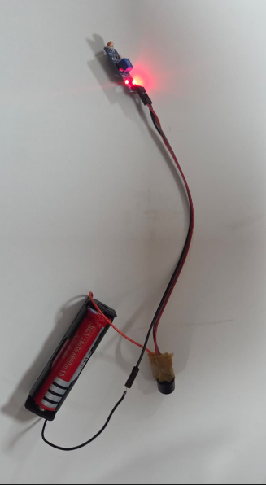
WORKING MODEL EXECUTION

